Slide 1

RakJak® Command Center
Model # RJCOMMAND
Assembly Instructions

Slide 2
Parts List
Reference | Mfg Part # | Description | Quantity
A | RJCOMMAND-BASE | Lower Round Base | 1
B | RJCOMMAND-TUBE195 | Lower Tube Assembly | 1
C | RJCOMMAND-TUBE16 | Upper Tube Assembly | 1
D | RJCOMMAND-CTRBKT | Center Bracket | 1
E | RJCOMMAND-HANDLE | Top Handle Assembly | 1
F | 2022 | 5/16-18 x ¾” Bolt | 8
G | 2023 | 5/16 Serrated Nut | 8
H | 4145-3 | 3” Caster Assembly | 5
I | 2008 | ½”-13 Serrated Lock Nut | 5

Slide 3
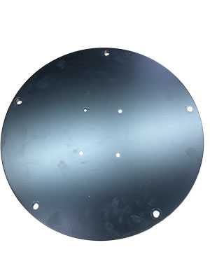
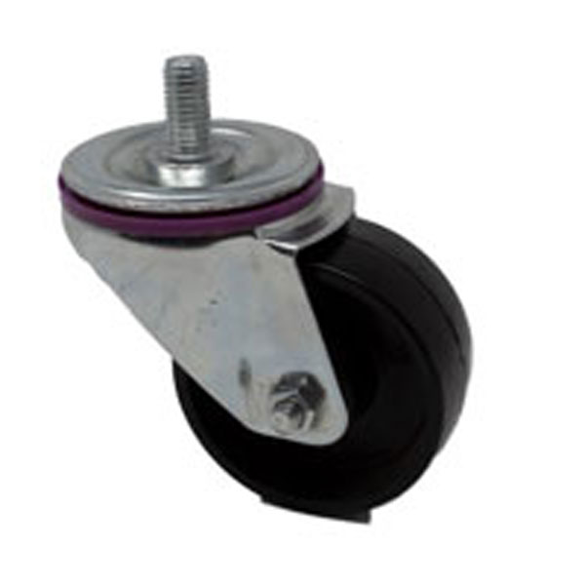
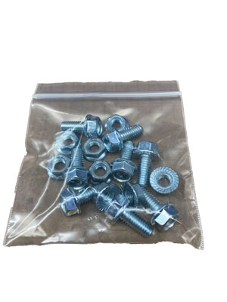
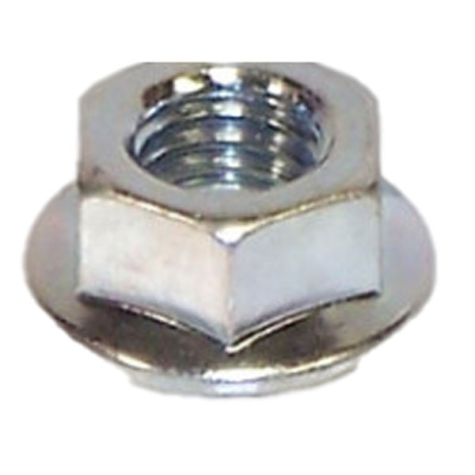
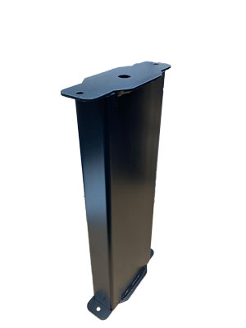
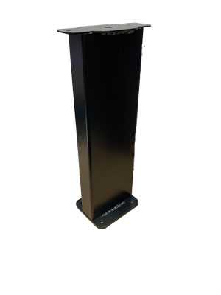
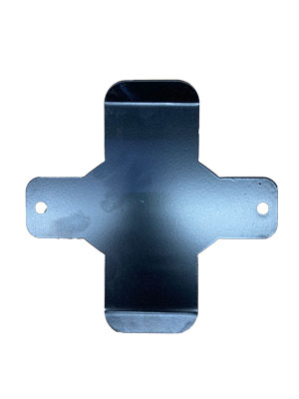
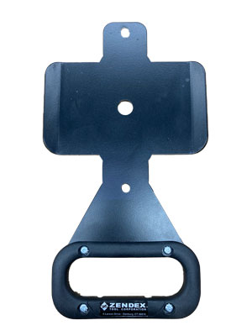
A x 1
F,G x 8
H x 5
I x 5
B x 1
C x 1
D x 1
E x 1

Slide 4
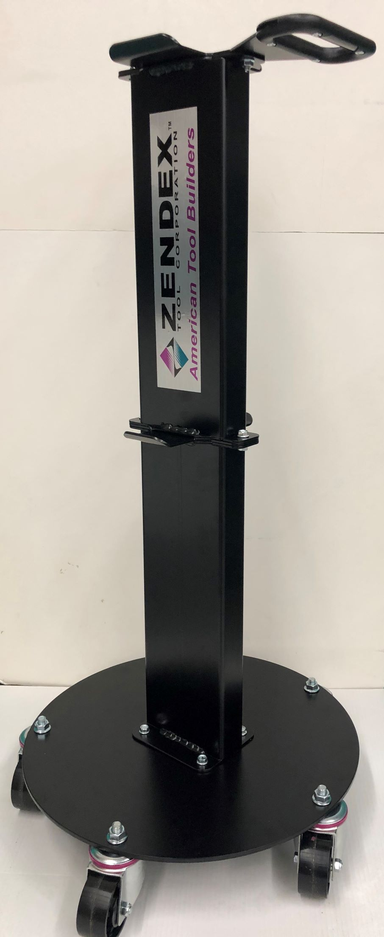
Assembly Instructions -
Starts from the base plate and works upward
Step 1
Attach Casters (H) to Lower Round Base (A) using Serrated Lock Nuts (I)
Step 2
Attach Lower Round Base (A) to Lower Tube (B) using hardware (F) & (G)
Step 3
Place center bracket (D) between the tube assemblies (B) & (C)***
Bolt and secure tightly using (F) & (G)
Bolt and secure the Top Handle (E) to Upper Tube Assembly (C) .
Step 4
***NOTE: Upper Tube has a small collar welded inside one end. Be sure that end is up. This small tube helps the Pivoting JakPad sit correctly.

Slide 5
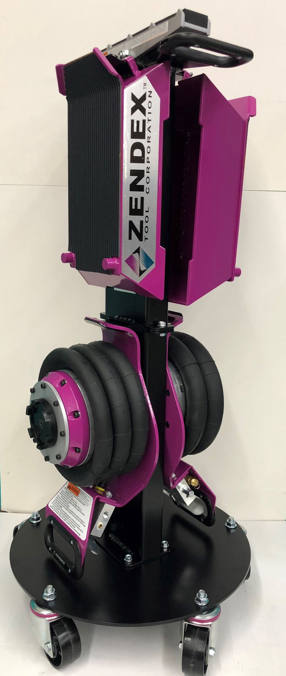
The Finished Product – Assembled & Loaded Command Center
Important notations:
  RAKJAKS will only fit on bottom brackets. This helps to lower the center of gravity for added stability.
  Do Not scale objects such as Air Lines, Nuts, Bolts etc. as rack may tip over.

